Slide 1
Hoofdstuk | Paragraaf
2 | 2.3, 2.4
3 | 3.1, 3.3, 3.4
6 | Alles
7 | Alles ( 7.4 niet)
8 | 8.1, 8.2

Slide 2
Summaries of numeric data
Center (mean, median, mode)
Spread (variance, standard deviation, z-score, coefficient of variation, IQR, MAD )
Shape (clustered, spread-out, bell-shaped)

Slide 3
Z-score
https://nl.wikipedia.org

Slide 4
Section 3.1
Independent sampling

Slide 5
Bivariate data
Data involving two data variables

Slide 6
Sports
Does the data seem to come from similar populations, that is do the two have the same shape?
Does the data seem to have similar center, similar spread?

Slide 7
Sports

Slide 8
Light speed (Michelson) density plot

Slide 9
Light speed (Michelson) qqplot (quantile)

Slide 10
Section 3.3
Paired data

Slide 11
Vitruvian Man (Leonardo da Vinci)

Slide 12
Vitruvian Man (Leonardo da Vinci)

Slide 13
Men’s body fat
Finding a simple relationship between neck and wrist diameter

Slide 14
Related data versus non-related data

Slide 15
Correlation
Correlation is a numeric summary for how closely related are the measurements of two numeric variables when they are in a linear relationship.

Slide 16
Correlation

Slide 17
Correlation

Slide 18
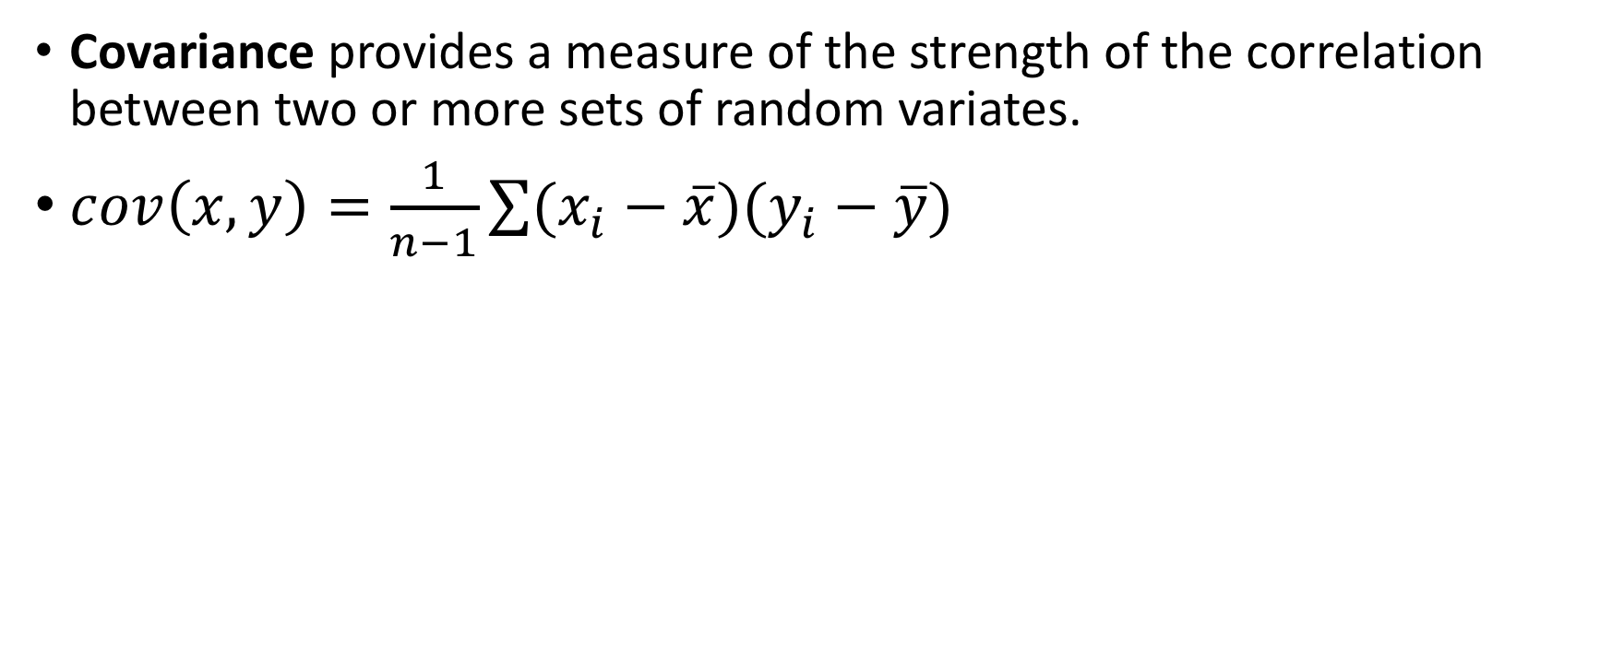
Covariance
Covariance provides a measure of the strength of the correlation between two or more sets of random variates.
$cov\left(x,y\right)=\frac{1}{n−1}\sum{(x_{i}−\overline{x})(y_{i}−\overline{y})}$

Slide 19
Covariance
Covariance is a measure of how much two random variables vary together. It’s similar to variance, but where variance tells you how a single variable varies, covariance tells you how two variables vary together.

Slide 20
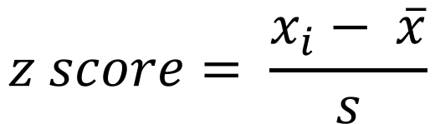
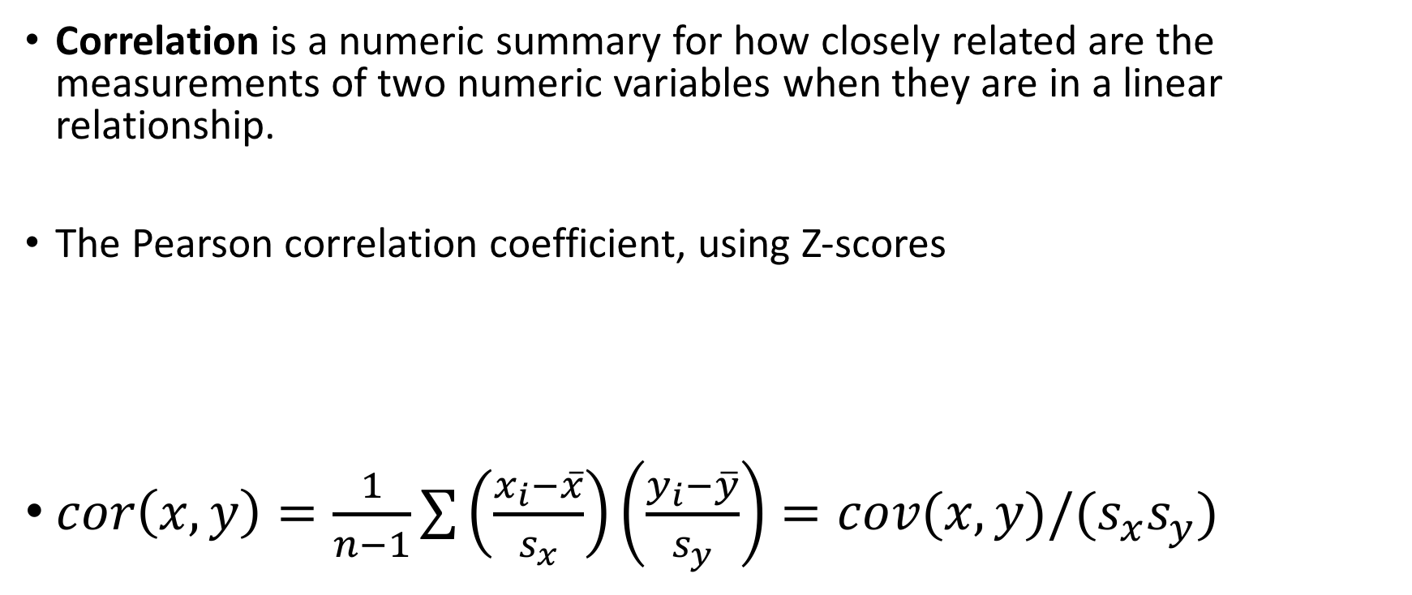
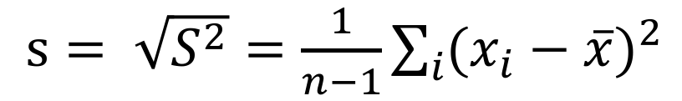
Correlation
Correlation is a numeric summary for how closely related are the measurements of two numeric variables when they are in a linear relationship.
The Pearson correlation coefficient, using Z-scores
$cor\left(x,y\right)=\frac{1}{n−1}\sum{\left(\frac{x_{i}−\overline{x}}{s_{x}}\right)}\left(\frac{y_{i}−\overline{y}}{s_{y}}\right)=cov(x,y)/(s_{x}s_{y})$
$$z score= \frac{x_{i}− \overline{x}}{s}$$
$s= \sqrt{S^{2}}=\frac{1}{n−1}\sum_{i}{{(x_{i}−\overline{x})}^{2}}$

Slide 21
Related data versus non-related data

Slide 22
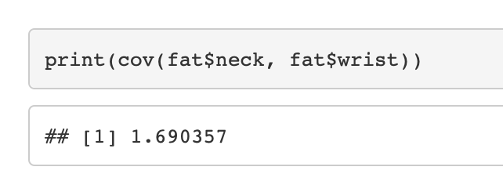
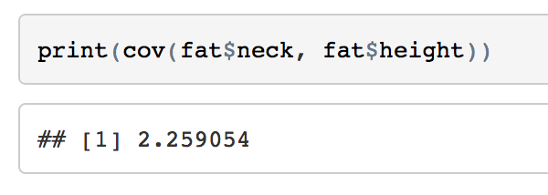
Related data versus non-related data

Slide 23
Spearman correlation
A measurement of association of relationship
Using ranked data
Summary of two numeric variables

Slide 24
Student SAT-score (Suite of Assessment)
More salary for teacher, results in better SAT-scores
Or doesn’t it?

Slide 25
Splitting the dataset
Simpson’s paradox
$perc = percentage of student who made the SAT test

Slide 26
Explanatory, response and lurking variables
Association: Correlation is not causation
Dashed line show association, solid arrows a cause-and effect-link.
x is explanatory, y is a response and z a lurking variable

Slide 27
Example correlation is not causation
Gun ownership in violence in Australia
Due to a shooting in Tasmania
Guns are bought back by the government
Gun-shootings and suicide rates declined afterwards
A negative correlation (-0.881) between the number of guns bought and de number of suicides can be observed.
So, less guns in society leads to viewer suicides
Or is there something else at play (lurking variable)?

Slide 28
Trends
Tooth length in guinea pigs
Increasing vitamin C
Dosage relates to longer teeth

Slide 29
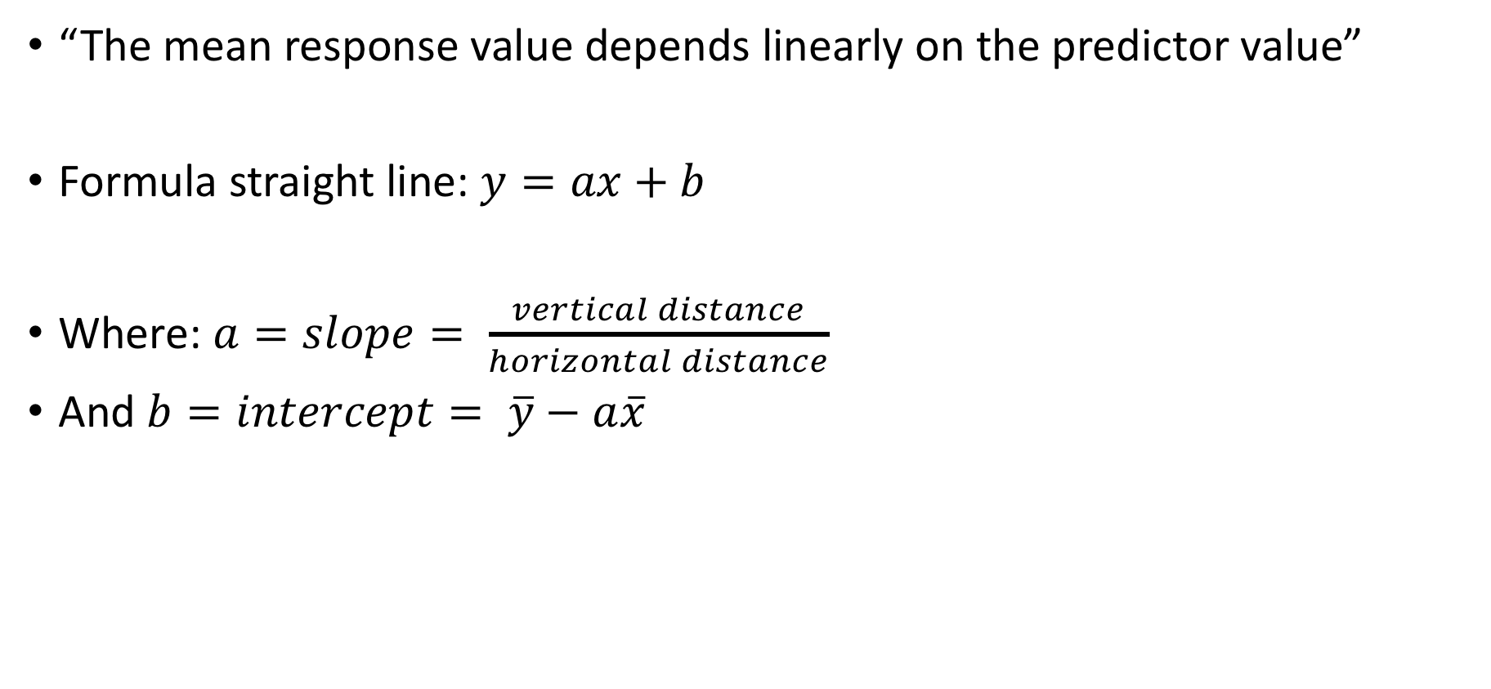
Linear model
“The mean response value depends linearly on the predictor value”
Formula straight line: $y=ax+b$
Where: $a=slope= \frac{vertical distance}{horizontal distance}$
And $b=intercept= \overline{y}−a\overline{x}$

Slide 30
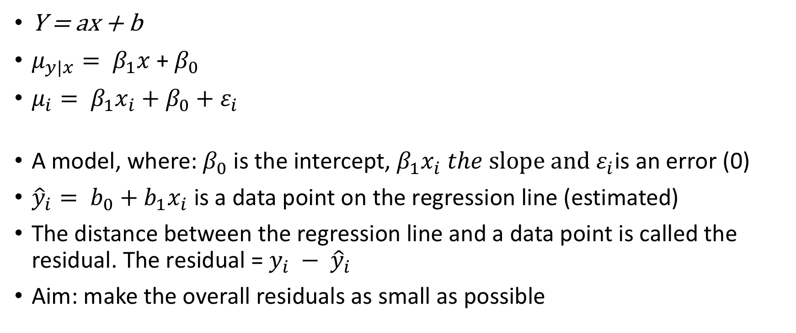
Linear model
$\text{Y}\text{ = }\text{ax}\text{ + }\text{b}$
$μ_{y|x}= β_{1}x$ + $β_{0}$
$μ_{i}= β_{1}x_{i}+β_{0}+ε_{i}$
A model, where: $β_{0}$ is the intercept, $β_{1}x_{i} the slope and ε_{i}$is an error (0)
${\hat{y}}_{i}= b_{0}+b_{1}x_{i}$ is a data point on the regression line (estimated)
The distance between the regression line and a data point is called the residual. The residual = $y_{i} − {\hat{y}}_{i}$
Aim: make the overall residuals as small as possible

Slide 31
Residuals

Slide 32
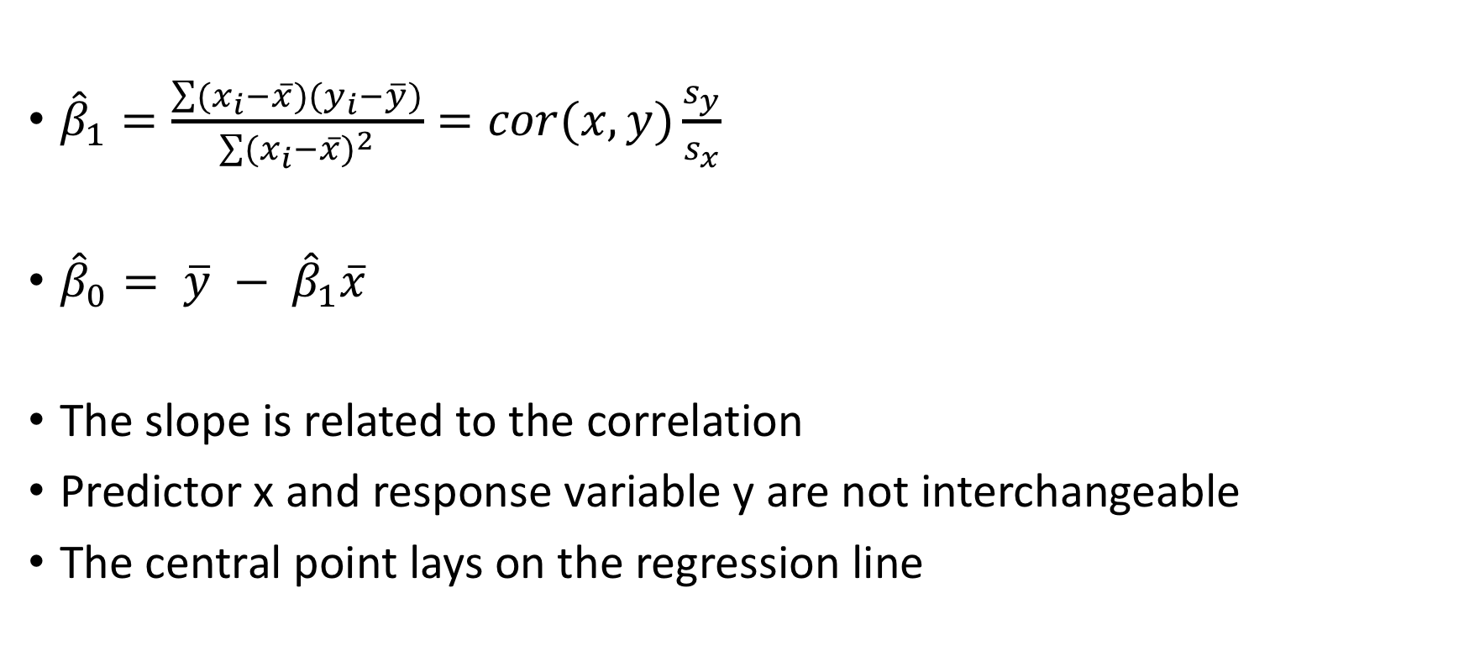

$$β_{0} and β_{1}$$
${\hat{β}}_{1}=\frac{\sum{(x_{i}−\overline{x})(y_{i}−\overline{y})}}{\sum{{(x_{i}−\overline{x})}^{2}}}=cor(x,y)\frac{s_{y}}{s_{x}}$
${\hat{β}}_{0}= \overline{y} − {\hat{β}}_{1}\overline{x}$
The slope is related to the correlation
Predictor x and response variable y are not interchangeable
The central point lays on the regression line

Slide 33
Least square regression

Slide 34
Heartrate
Calculate the regression line
for the “heartrate” dataset:
Is there a relationship between
age and the maximum heartrate?

Slide 35
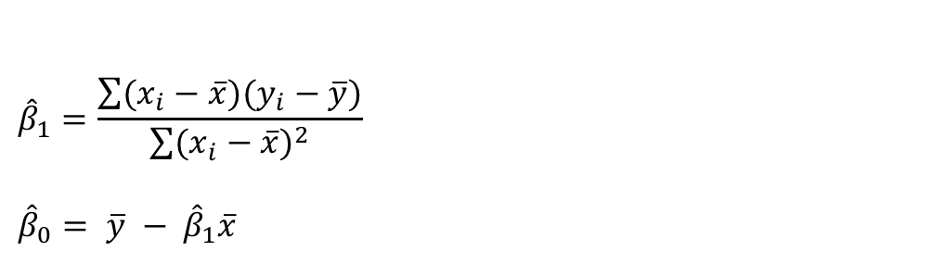
$${\hat{β}}_{1}=\frac{\sum{(x_{i}−\overline{x})(y_{i}−\overline{y})}}{\sum{{(x_{i}−\overline{x})}^{2}}}$$
$${\hat{β}}_{0}= \overline{y} − {\hat{β}}_{1}\overline{x}$$
Heartrate

Slide 36
lm function

Slide 38
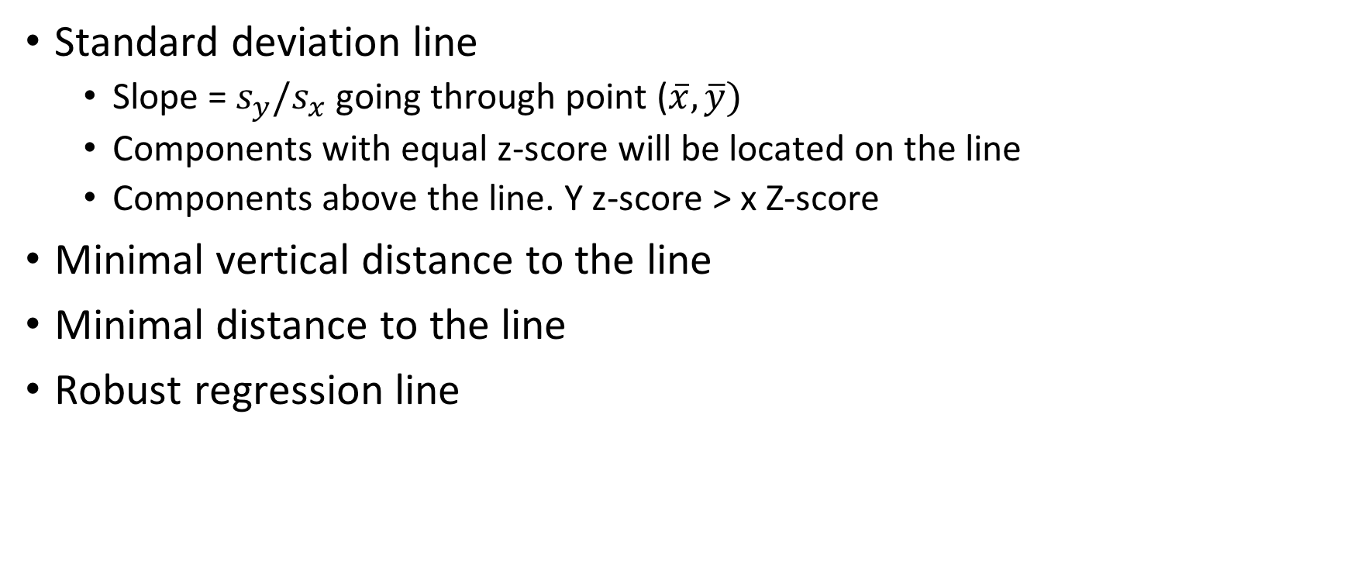
Alternative trend lines
Standard deviation line
Slope = $s_{y}/s_{x}$ going through point ($\overline{x}, \overline{y})$
Components with equal z-score will be located on the line
Components above the line. Y z-score > x Z-score
Minimal vertical distance to the line
Minimal distance to the line
Robust regression line

Slide 39
Section 3.4
Bivariate categorical data

Slide 40
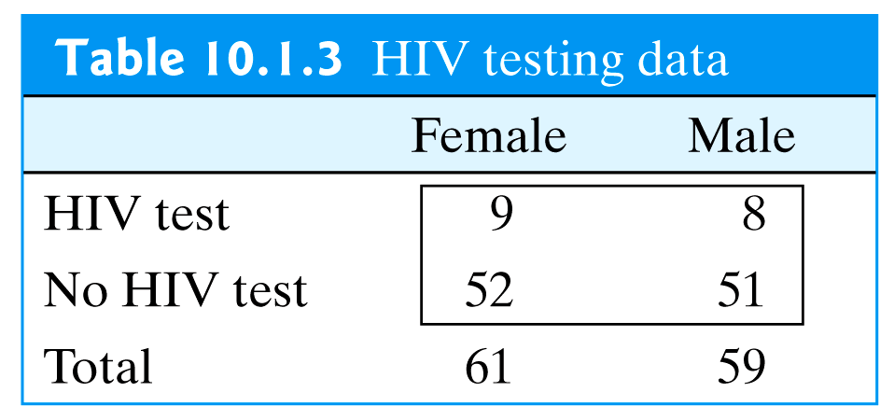
Contingency table
Is there a relationship between the variables
The focus of interest in a contingency table is de dependence or association between the column variable and the row variable.
The word contingent means “dependent”
A 2 X 2 contingency table (has four cells)
Table from:

Slide 41
Seatbelts

Slide 42
Marginal distribution
Two-way table involves two variables
The distribution of each variable separately is the Marginal distribution
Sum down the rows over the columns (or rows)

Slide 43
Conditional distribution of two-way table
Does the fact that parents wear a seat belt affect the change a child does?
We inspect the row proportions
Calculate the percentages such that the rows add up to 100%, columns need not.
88% of children are buckled when the parents are and 11 % of children are while the parents aren’t

Slide 44
Bar plot

Slide 45
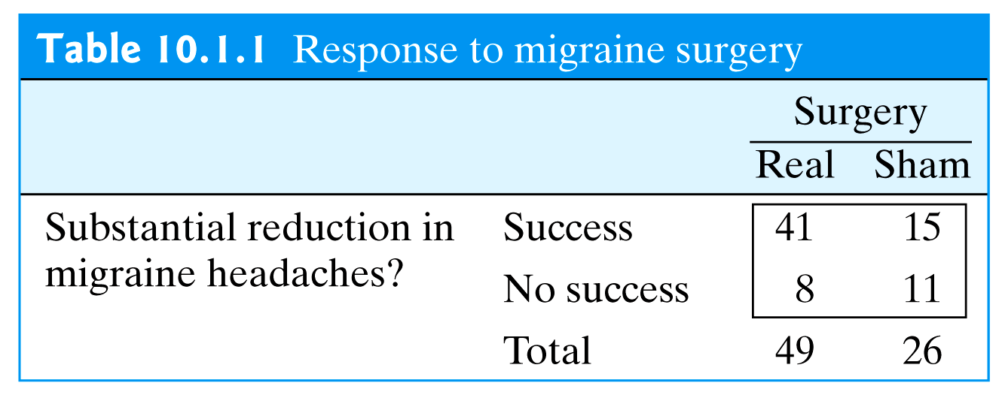
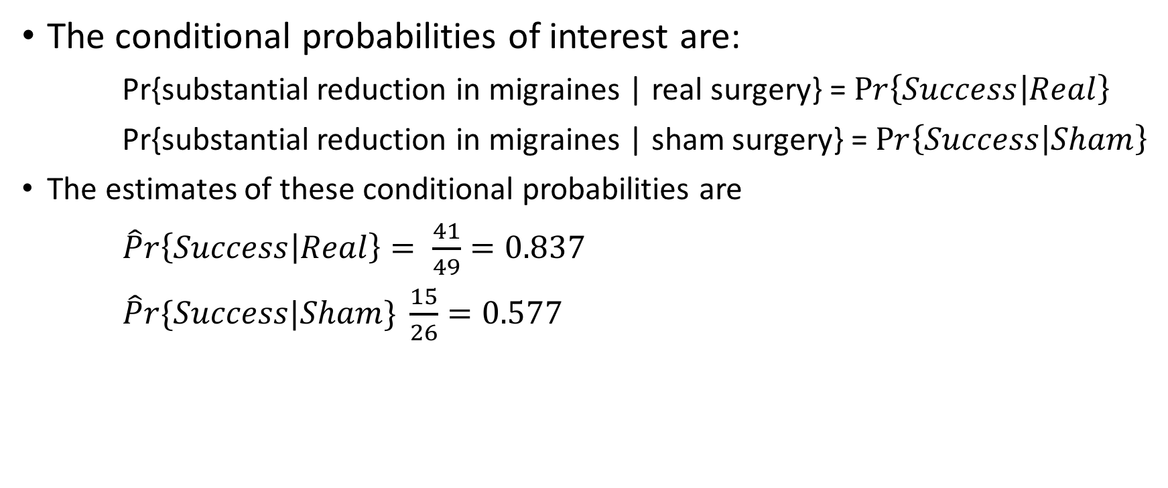
Migraine and headache
The conditional probabilities of interest are:
Pr{substantial reduction in migraines | real surgery} = $Pr\left\{Success | Real\right\}$
Pr{substantial reduction in migraines | sham surgery} = $Pr\left\{Success | Sham\right\}$
The estimates of these conditional probabilities are
$\hat{P}r\left\{Success | Real\right\}= \frac{41}{49}=0.837$
$\hat{P}r\{Success|Sham\} \frac{15}{26}=0.577$
Table from:

Slide 46
Mosaic plot

Slide 47
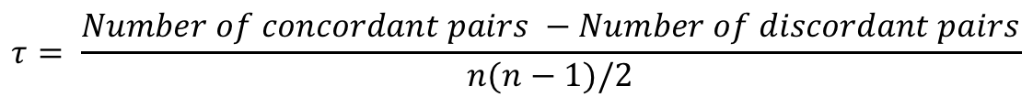
Kendall statistic (tau)
A measure of association between data, THAT CAN BE RANKED, has a natural order.
An alternative for "pearson", "spearman” of the cor() function in R
$$τ= \frac{Number of concordant pairs −Number of discordant pairs}{n(n−1)/2}$$

Slide 48
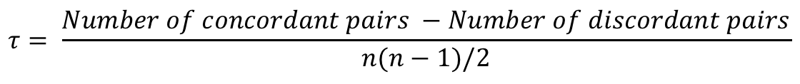
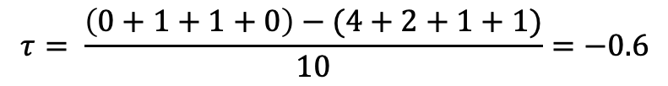
Kendall statistic (tau)
A measure of association between data, THAT CAN BE RANKED, a natural order.
0 points in the third quadrant (concordant)
1 in the second and 1 in fourth quadrant (discordant)
Discordant
$$τ= \frac{Number of concordant pairs −Number of discordant pairs}{n(n−1)/2}$$
Concordant
$$τ= \frac{\left(0+1+1+0\right)−(4+2+1+1)}{10}=−0.6$$

Slide 49
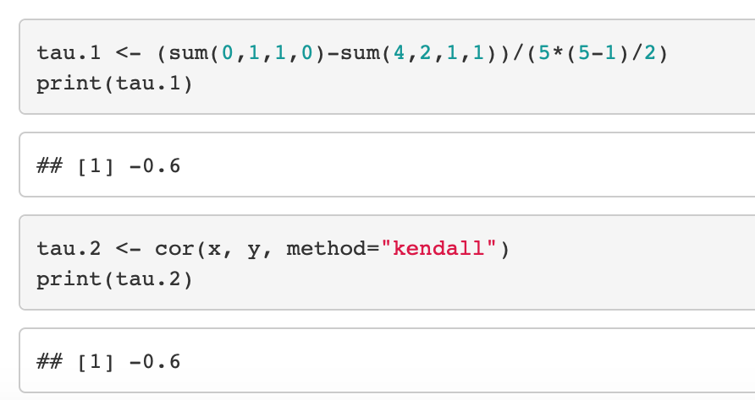
Kendall statistic (tau)

Slide 50
Chi-square statistic

Slide 51
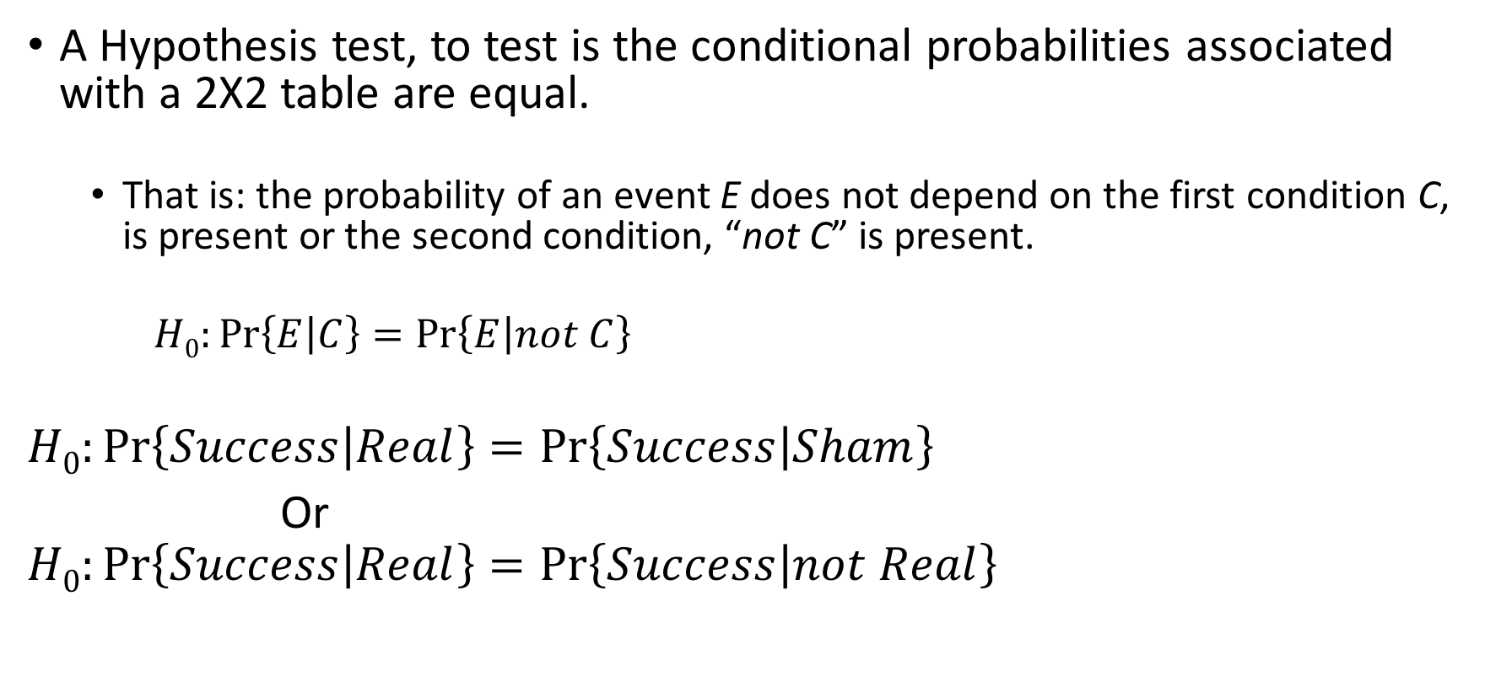
Migraine Headache
A Hypothesis test, to test is the conditional probabilities associated with a 2X2 table are equal.
That is: the probability of an event E does not depend on the first condition C, is present or the second condition, “not C” is present.
$H0:\operatorname{Pr}\left\{E | C\right\}=\operatorname{Pr}\left\{E | not C\right\}$
$$H0:\operatorname{Pr}\left\{Success | Real\right\}=\operatorname{Pr}\left\{Success | Sham\right\}$$
Or
$$H0:\operatorname{Pr}\left\{Success | Real\right\}=\operatorname{Pr}\left\{Success | not Real\right\}$$

Slide 52
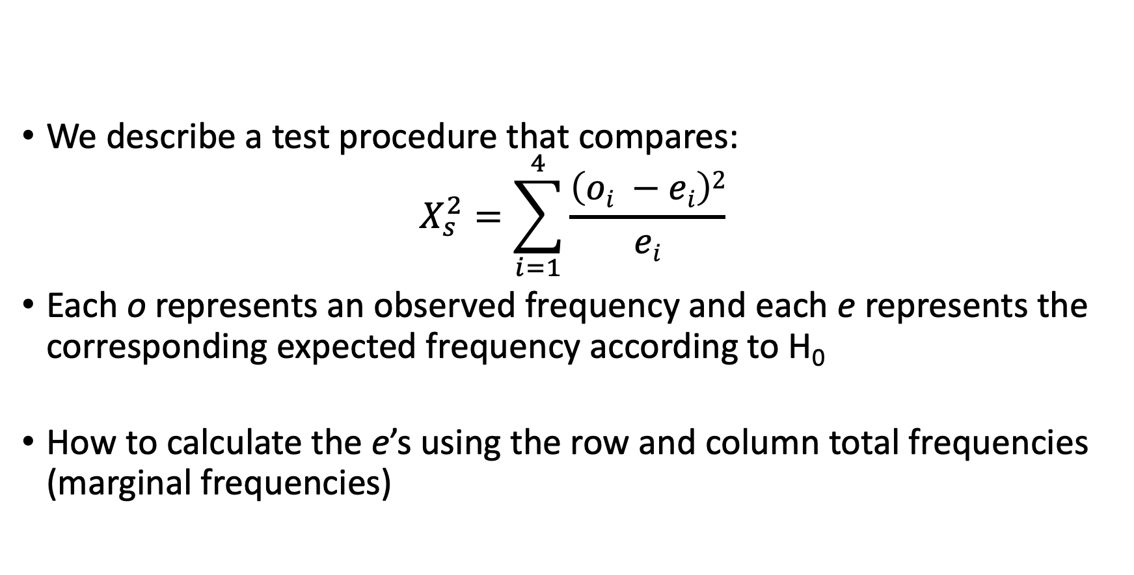
The Chi-square statistics
We describe a test procedure that compares:
$$X_{s}^{2}=\sum_{i=1}^{4}{\frac{\left(oi −ei\right)2}{ei}}$$
Each o represents an observed frequency and each e represents the corresponding expected frequency according to H₀
How to calculate the e’s using the row and column total frequencies (marginal frequencies)

Slide 53
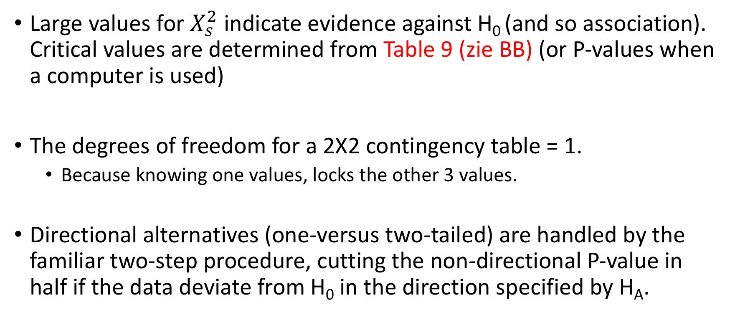
The test procedure
Large values for $X_{s}^{2}$ indicate evidence against H₀ (and so association). Critical values are determined from Table 9 (zie BB) (or P-values when a computer is used)
The degrees of freedom for a 2X2 contingency table = 1.
Because knowing one values, locks the other 3 values.
Directional alternatives (one-versus two-tailed) are handled by the familiar two-step procedure, cutting the non-directional P-value in half if the data deviate from H₀ in the direction specified by H_{A}.

Slide 54
TABEL 9. Critical Values of the Chi-Square Distribution
Column headings are non-directional P-values.
If HA is directional, the directional P-values are found by dividing the column headings in half

Slide 55
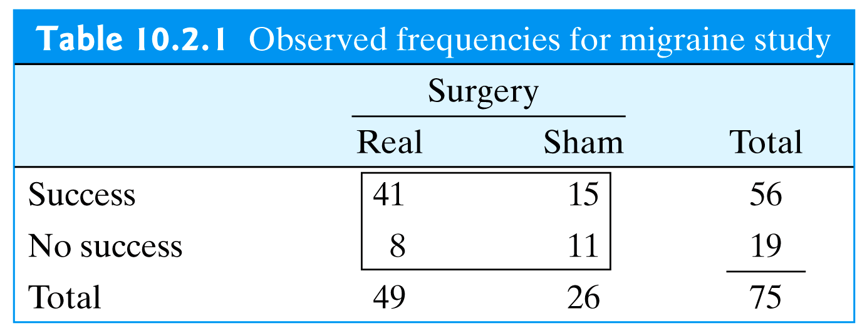
Calculating the expected probabilities
The e’s should agree exactly with the null hypothesis. Because H₀ asserts that the probability of success does not depend on the treatment.
Table from:

Slide 56
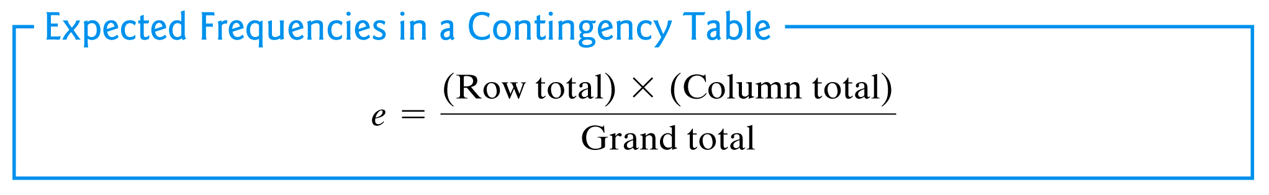
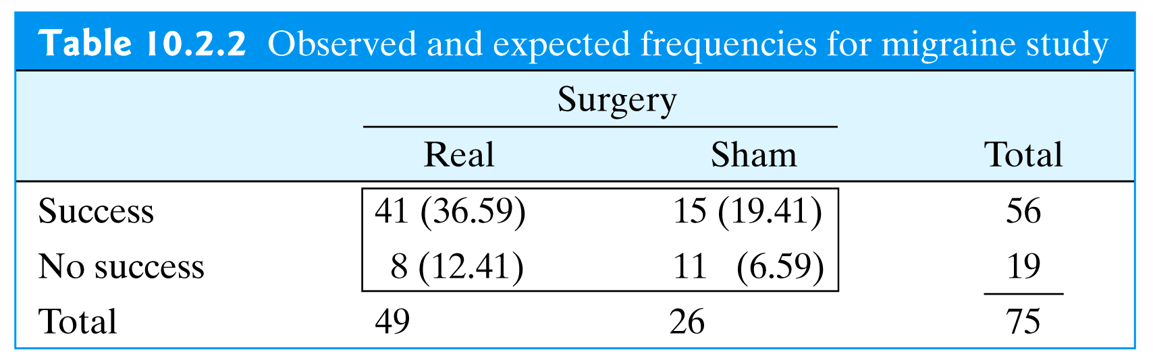
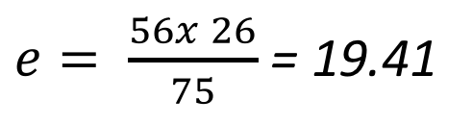
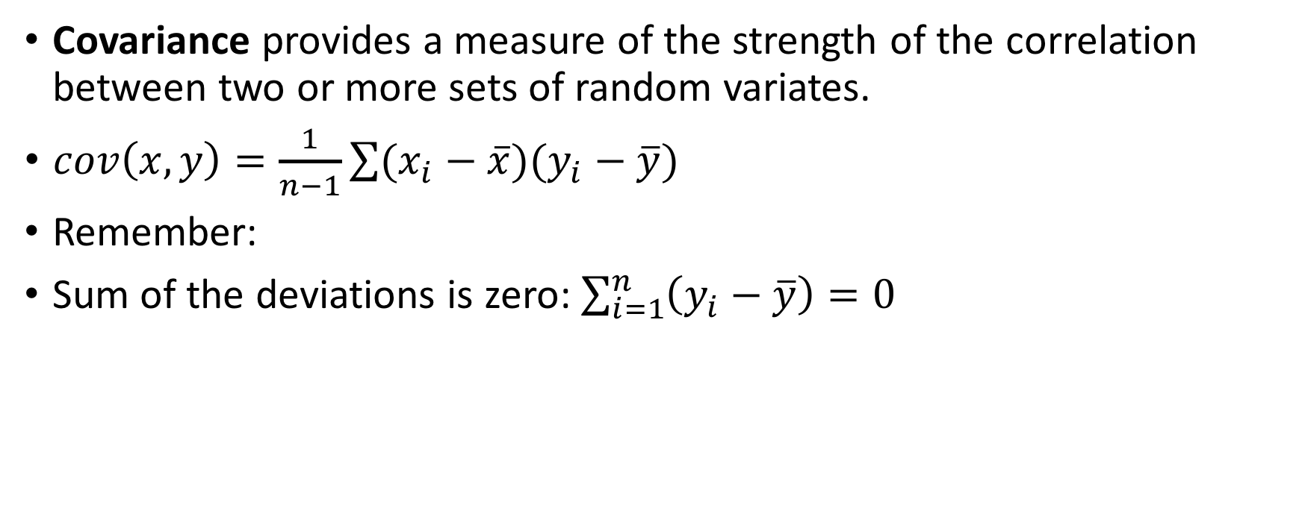
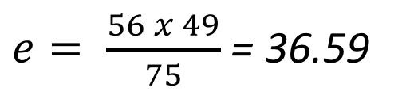
Calculating the expected probabilities (e)
$e= \frac{56 x 49}{75}$ = 36.59
$e= \frac{56x 26}{75}$ = 19.41
$e= \frac{19 x 49}{75}$ = 12.41
$e= \frac{19x 26}{75}$ = 6.59

Slide 57
Migraine Headache
Using ⍺ = 0.01
H₀: The real surgery is no better than the sham surgery for reducing migraine headache
H_{A}: The real surgery is better than the sham surgery for reducing migraine headache.
$H0:\operatorname{Pr}\left\{Success | Real\right\}=\operatorname{Pr}\left\{Succes | Sham\right\}$
$HA:\operatorname{Pr}\left\{Success | Real\right\}>Pr⁡\{Succes|Sham\}$

Slide 58
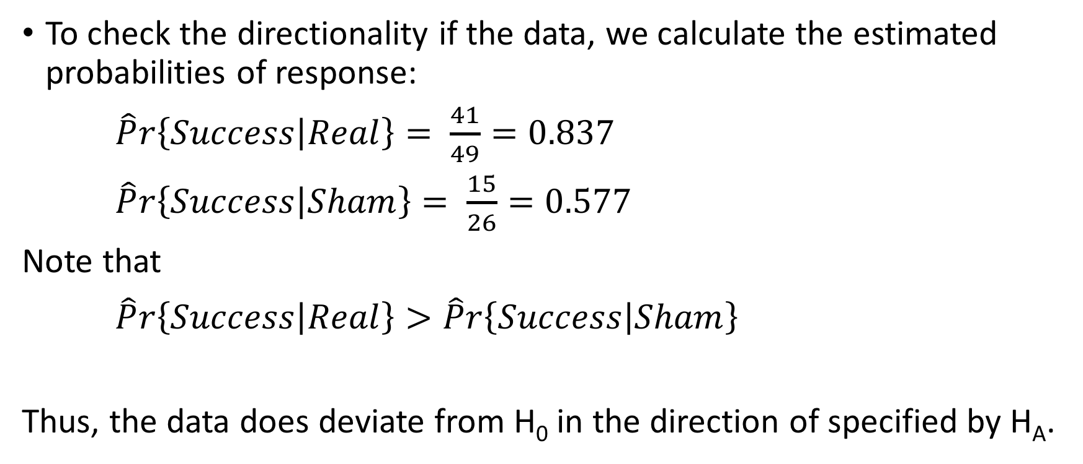
Migraine Headache
To check the directionality if the data, we calculate the estimated probabilities of response:
$\hat{P}r\left\{Success | Real\right\}= \frac{41}{49}=0.837$
$\hat{P}r\left\{Success | Sham\right\}= \frac{15}{26}=0.577$
Note that
$\hat{P}r\left\{Success | Real\right\}> \hat{P}r\left\{Success | Sham\right\}$
Thus, the data does deviate from H₀ in the direction of specified by H_{A}.

Slide 59
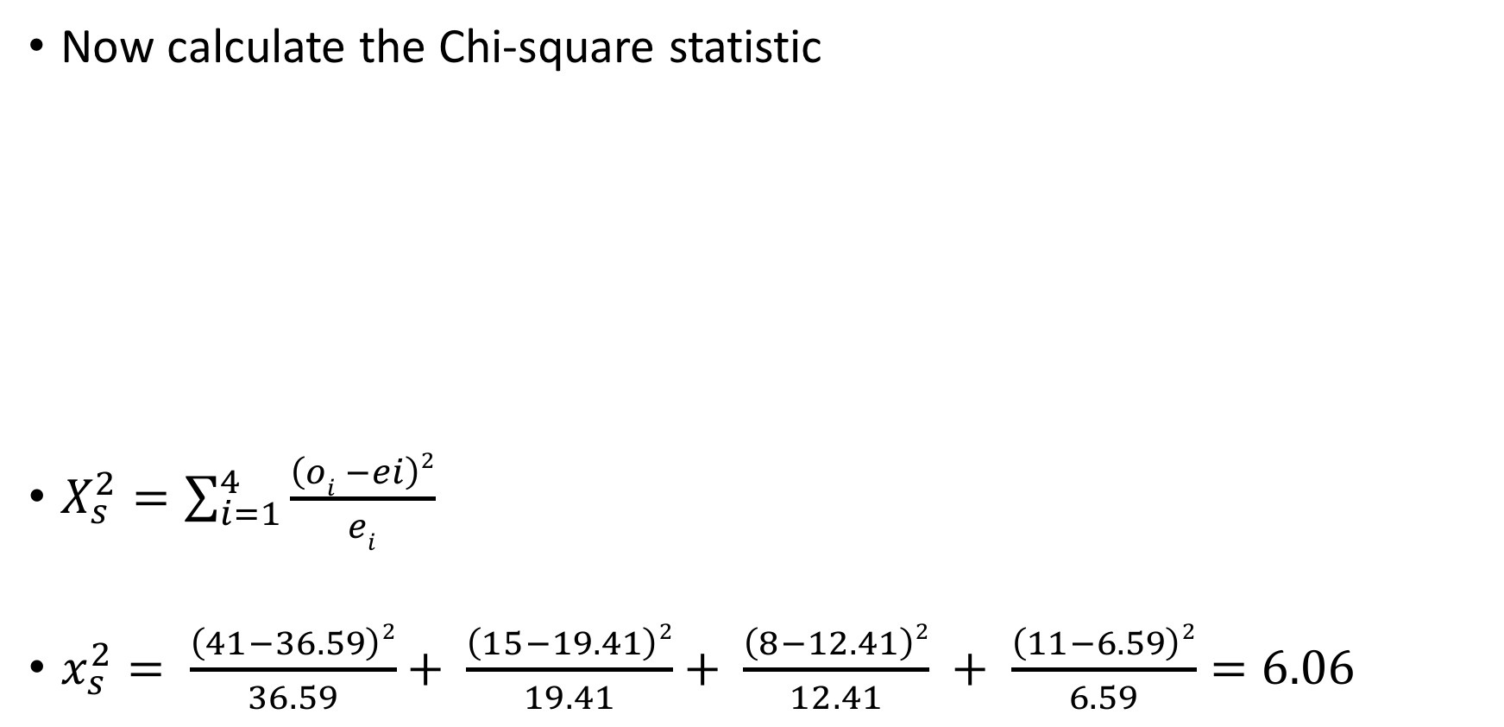
Migraine Headache
Now calculate the Chi-square statistic
$X_{s}^{2}=\sum_{i=1}^{4}{\frac{\left(oi −ei\right)2}{ei}}$
$x_{s}^{2}= \frac{\left(41−36.59\right)2}{36.59}+ \frac{\left(15−19.41\right)2}{19.41}+ \frac{\left(8−12.41\right)2}{12.41} + \frac{\left(11−6.59\right)2}{6.59}=6.06$

Slide 60
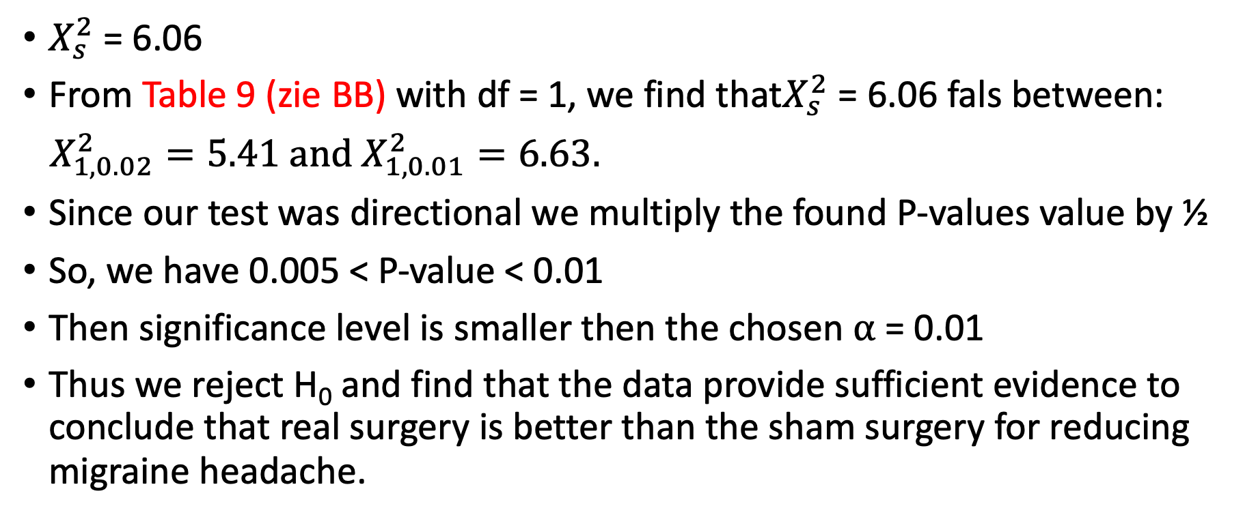
Migraine Headache
$X_{s}^{2}$ = 6.06
From Table 9 (zie BB) with df = 1, we find that$X_{s}^{2}$ = 6.06 fals between:
$X_{1,0.02}^{2}=5.41 and{ X}_{1,0.01}^{2}=6.63.$
Since our test was directional we multiply the found P-values value by ½
So, we have 0.005 < P-value < 0.01
Then significance level is smaller then the chosen ⍺ = 0.01
Thus we reject H₀ and find that the data provide sufficient evidence to conclude that real surgery is better than the sham surgery for reducing migraine headache.

Slide 61
Migraine Headache

Slide 62
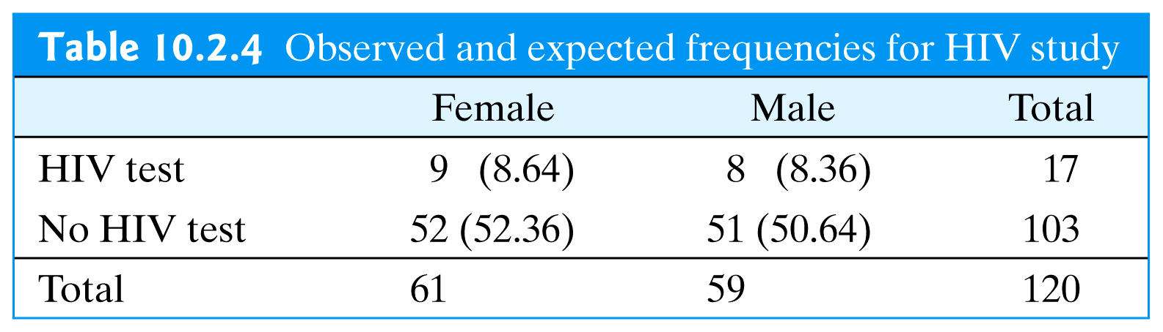
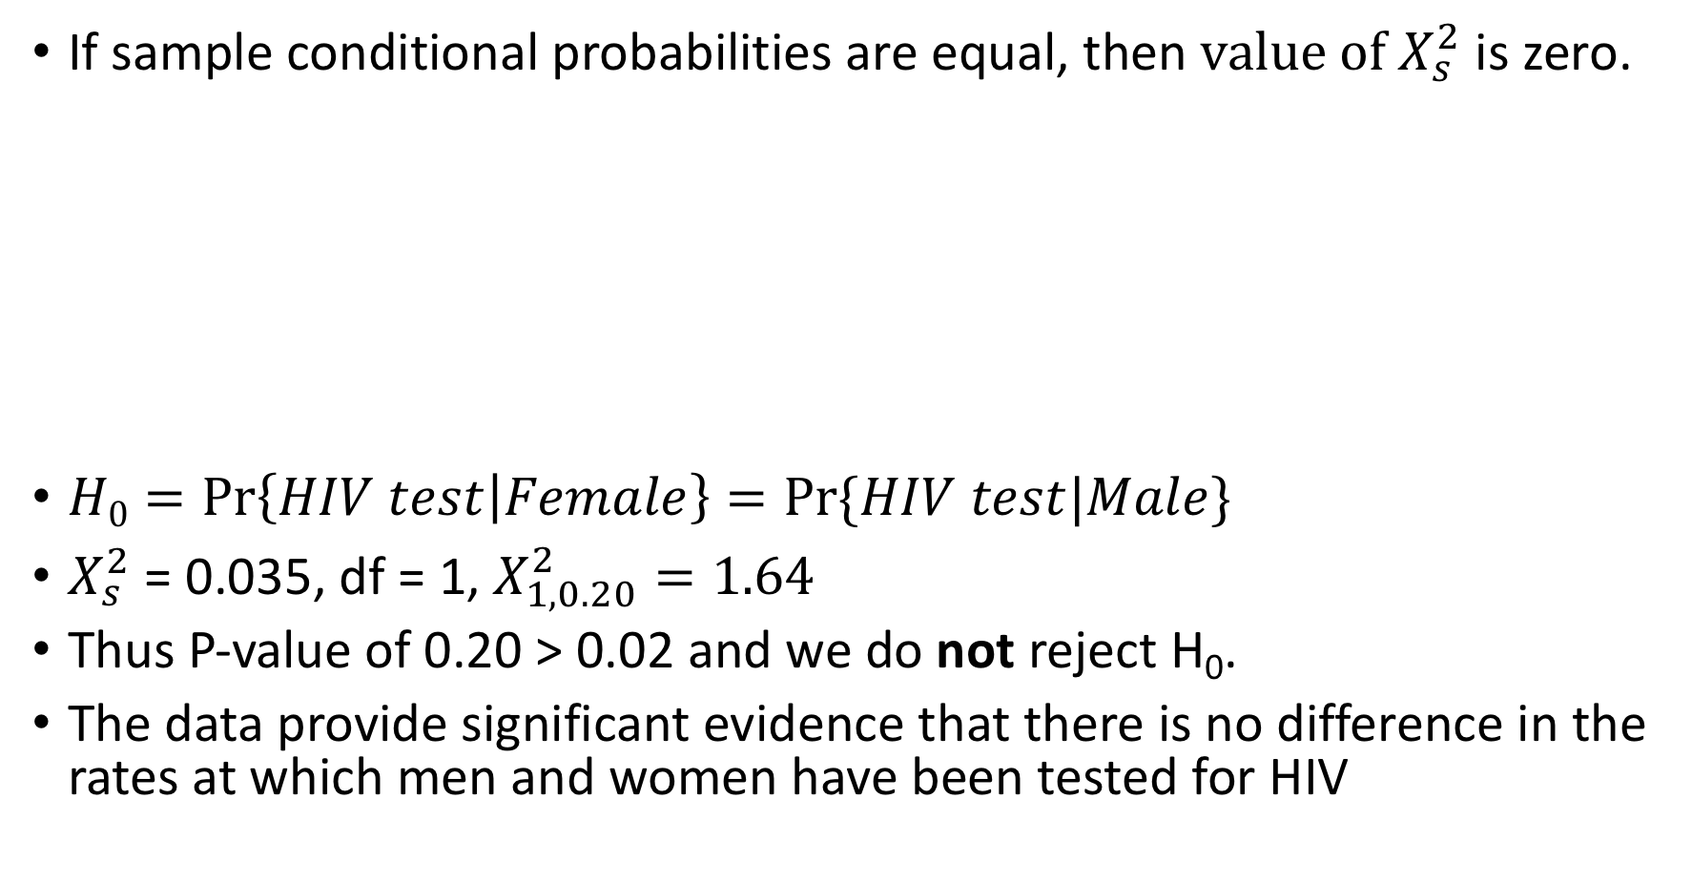
Illustrations of the null hypothesis (1)
If sample conditional probabilities are equal, then $value of X_{s}^{2}$ is zero.
$H0=\operatorname{Pr}\left\{HIV test | Female\right\}=Pr⁡\{HIV test|Male\}$
$X_{s}^{2}$ = 0.035, df = 1, $X_{1,0.20}^{2}=1.64$
Thus P-value of 0.20 > 0.02 and we do not reject H₀.
The data provide significant evidence that there is no difference in the rates at which men and women have been tested for HIV
Table from:

Slide 63
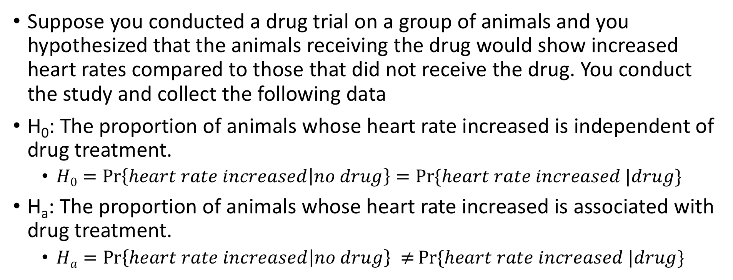
Illustrations of the null hypothesis (2)
Suppose you conducted a drug trial on a group of animals and you hypothesized that the animals receiving the drug would show increased heart rates compared to those that did not receive the drug. You conduct the study and collect the following data
H₀: The proportion of animals whose heart rate increased is independent of drug treatment.
$H0=\operatorname{Pr}\left\{heart rate increased | no drug\right\}=Pr⁡\{heart rate increased |drug\}$
H_{a}: The proportion of animals whose heart rate increased is associated with drug treatment.
$Ha=\operatorname{Pr}\left\{heart rate increased | no drug\right\} ≠Pr⁡\{heart rate increased |drug\}$

Slide 64
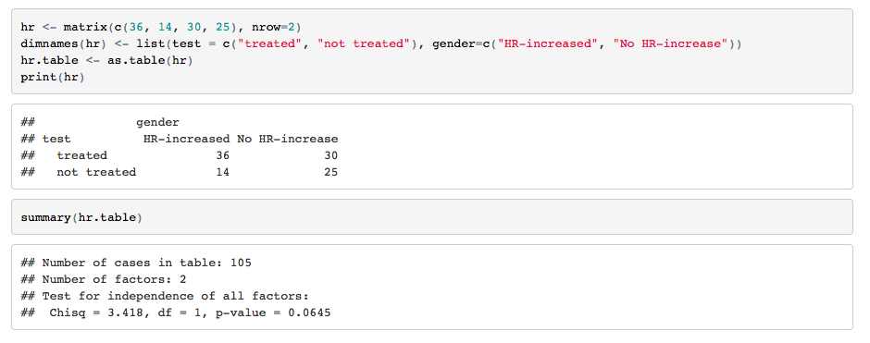
Since a p-value of 0.65 is greater than the conventionally accepted significance level of ⍺ = 0.05
(i.e. p > 0.05) we fail to reject the null hypothesis. In other words, there is no statistically significant difference in the proportion of animals whose heart rate increased.

